Slide 1


Organizational Excellence Framework, models, assessment
David Vykydal Eva Tylečková
© Organizational Excellence: Framework, models, assessment © 2024 by David Vykydal, Eva Tylečková is licensed under CC BY-NC 4.0
© VSB - Technical University of Ostrava

Slide 2
Organizational Excellence: Models a assessment Introduction to the issue.
„Organizational excellence is not about management of the quality. It is about the quality of management.”
Haim Berman
WHAT IS TQM?
TQM or Total Quality Management is a management philosophy and structured management approach based on the belief that an organization’s continuous effort can contribute to its long-term success.
31/07/24
Advanced Quality Management Systems

Slide 3
WHAT IS ORGANIZATIONAL EXCELLENCE?
According to EFQM:
„Outstanding practice in managing the organization and achieving results based on set of fundamental concepts.“
According to M. Webster:
„Organization´s ability to deliver the highest possible performance that exceeds expectations of all interested parties.“
„An excellent organizations achieve and sustain outstanding levels of performance that meet or exceed the expectations of all their stakeholders.“
From EFQM Excellence Model, version for 2013
31/07/24
Advanced Quality Management Systems

Slide 4
FEATURES OF EXCELLENT ORGANIZATIONS:
They highly exceed „mere average“ of performance within relevant branch of business,
their leaders have and are able to reach clear vision, mission and values through,
they understand that adding the highest stakeholders value is their primary reason for being,
they are strongly oriented to all stakeholders´ requirements, not only external customers,
they see that excellent results are reached as a logic effect of advanced and continuously developed management systems,
they are distinguished through the highest level of overall culture,
31/07/24
Advanced Quality Management Systems

Slide 5
FEATURES OF EXCELLENT ORGANIZATIONS:
soft items of management are usually preferred to hard methods and tools there,
instead „ex post“ actions, a prevention principle is in place everywhere,
all suitable approaches to organization´s learning are exploited by systematic manner,
they are strongly oriented to products and processes innovations and people creativity,
they systematically define, manage and improve key processes,
they are aware of their role within sustained development of regional and national economy.
31/07/24
Advanced Quality Management Systems

Slide 6
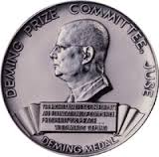

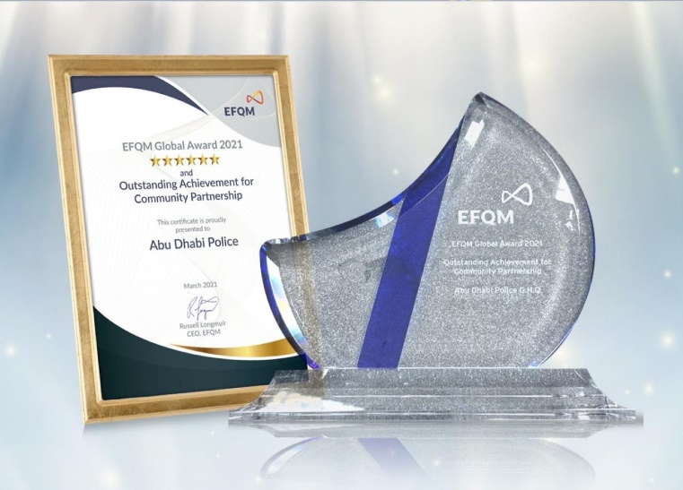
WHAT ARE BUSINESS EXCELLENCE MODELS (BEMs)?
According to the Asian Productivity Organization:
„Tool which help organizations to assess their strengths and areas for improvement and guide them on what to do next. They provide senior managers with holistic method with which to manage their business and get by and into key decisions that will lead to sustainable and measurable success. “
Deming Prize Model
(www.juse.or.jp/deming)
Baldrige Excellence Framework
(www.nist.gov/baldrige)
EFQM Model
(www.efqm.org)
31/07/24
Advanced Quality Management Systems

Slide 7
Most of BEMs have some similarities:
all have the TQM concept as their basis,
all have some criteria, usually named as enablers (approaches) and results,
relationships between the criteria show how the elements of these criteria are linked together,
defined criteria cover similar ground,
all models emphasize that the end purpose is to create a more effective and efficient organization, better oriented to the needs of all relevant stakeholders,
all models place particular emphasis on measuring the outcomes of improved processes effectiveness,
all criteria are meant to act as a framework for necessary improvements and changes,
all criteria are relatively open and non - prescriptive and organizations can use flexible approaches and suitable methods and metrics.
31/07/24
Advanced Quality Management Systems

Slide 8
THE ORGANIZATIONAL EXCELLENCE MODELS – SOME FEATURES
Excellence Model | Basic features
Deming Prize Model | It represents probably the oldest model throughout the world. It has been continuously developing and using since 1951. It accents wide application of statistical approach to data processing. Established criteria are a little bit unspecific. This model is mostly applied in countries at South-East Asia.
Malcolm Baldrige National Quality Award Model | It was created in 1987 with strong support of US government. Criteria was gradually developed for different areas (business, education, healthcare, etc.) and they are permanently refined. This model is highly respected especially at North America, but its implementation could be discovered also at other continents.
31/07/24
Advanced Quality Management Systems

Slide 9
THE ORGANIZATIONAL EXCELLENCE MODELS – SOME FEATURES
Excellence Model | Basic features
Model EFQM | The first version of this model was launched in 1991 as European Model of TQM. Its criteria are fully generic, and it is recognized as the most exacting excellence model at present. All criteria are divided to two parts: enablers, as well as results. It is widely used particularly in European countries and also serves as fundament of many national quality awards.
Kanji´s Business Excellence Structural Model | Kanji has already launched the first version of his model in 1998. Leadership role is appreciated as a key one. It is a set of fairly intangible recommendations. This model is known and applied at different organizations in Europe and Asia.
31/07/24
Advanced Quality Management Systems

Slide 10
THE ORGANIZATIONAL EXCELLENCE MODELS – SOME FEATURES
Excellence Model | Basic features
4P and 3C Model | Primarily, soft items of management are stressed by this model. Leadership role is strongly oriented to overall development of company culture. Practical implementation of this model asks for manager´s creativity.
31/07/24
Advanced Quality Management Systems

Slide 11

WHAT IS EFQM?
The European Foundation for Quality Management (EFQM)
It is a membership based non-profit organization, created in 1988 by fourteen leading European businesses, with the Mission to be driving force for sustainable excellence in Europe and a Vision of a world in which European organizations excel. EFQM aims to lead the global excellence movement.
More than 600 organizations from all over the world are members of EFQM at present. The VSB-Technical University of Ostrava become a member in 1996.
Please, visit: www.efqm.org
31/07/24
Advanced Quality Management Systems

Slide 12
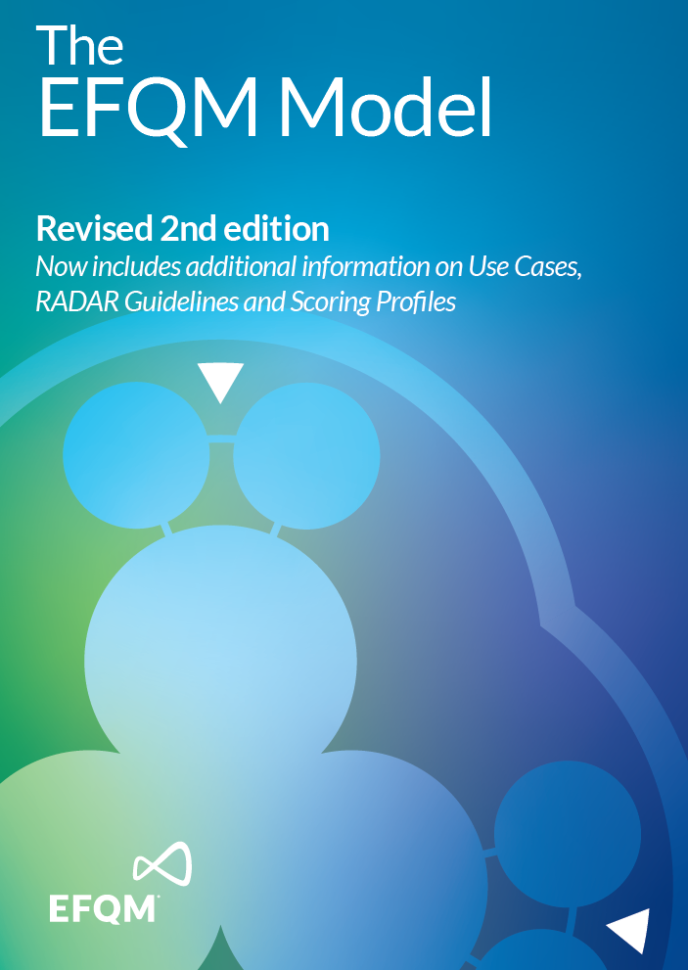
WHAT IS EFQM MODEL?
The model is pragmatic, generic and practical tool, developed by leading organizations to stimulate continuous improvement.
It allows people to understand the cause and effect relationships between what their organization does and the results achieved.
It provides a basic structure for coherent, effective and efficient management system building and development.
It creates basis for national and global quality awarding.
This model comprises of a set of three integrated components.
31/07/24
Advanced Quality Management Systems

Slide 13
INTEGRATED COMPONENTS OF THE EFQM MODEL
COMPONENTS OF THE EFQM MODEL
They define the underlying principles for achieving sustainable excellence.
Concepts of Excellence
They provide a framework to help organizations to establish and assess level of excellence.
It is powerful tool for driving systematic improvement in all areas of the organization!
EFQM MODEL
Criteria
RADAR
31/07/24
Advanced Quality Management Systems

Slide 14
EXCELLENCE – FUNDAMENTAL CONCEPTS
Sustaining Outstanding Results
Managing with Agility
Creating a Sustainable Future
Succeeding through the Talent of People
EXCELLENCE – FUNDAMENTAL CONCEPTS
Developing Organisational Capability
Adding Value for Customers
Leading with Vision, Inspiration and Integrity
Harnessing Creativity and Innovation
31/07/24
Advanced Quality Management Systems

Slide 15
Sustaining Outstanding Results
Excellent organisations achieve outstanding results that meet both the short and long term needs of all their stakeholders, within the context of their operating environment.
Adding Value for Customers
Excellent organisations consistently add value for customers by understanding, anticipating and fulfilling needs, expectations and opportunities.
Creating a Sustainable Future
Excellent organisations have a positive impact on the world around them by enhancing their performance whilst simultaneously advancing the economic, environmental and social conditions within the communities they touch.
31/07/24
Advanced Quality Management Systems

Slide 16
Developing Organisational Capability
Excellent organisations enhance their capabilities by effectively managing change within and beyond the organisational boundaries.
Harnessing Creativity and Innovation
Excellent organisations generate increased value and levels of performance through continual improvement and systematic innovation by harnessing the creativity of their stakeholders.
Leading with Vision, Inspiration and Integrity
Excellent organisations have leaders who shape the future and make it happen, acting as role models for its values and ethics.
31/07/24
Advanced Quality Management Systems

Slide 17
Managing with Agility
Excellent organisations are widely recognised for their ability to identify and respond effectively and efficiently to opportunities and threats.
Succeeding through the Talent of People
Excellent organisations value their people and create a culture of empowerment for the achievement of both organisational and personal goals.
31/07/24
Advanced Quality Management Systems

Slide 18
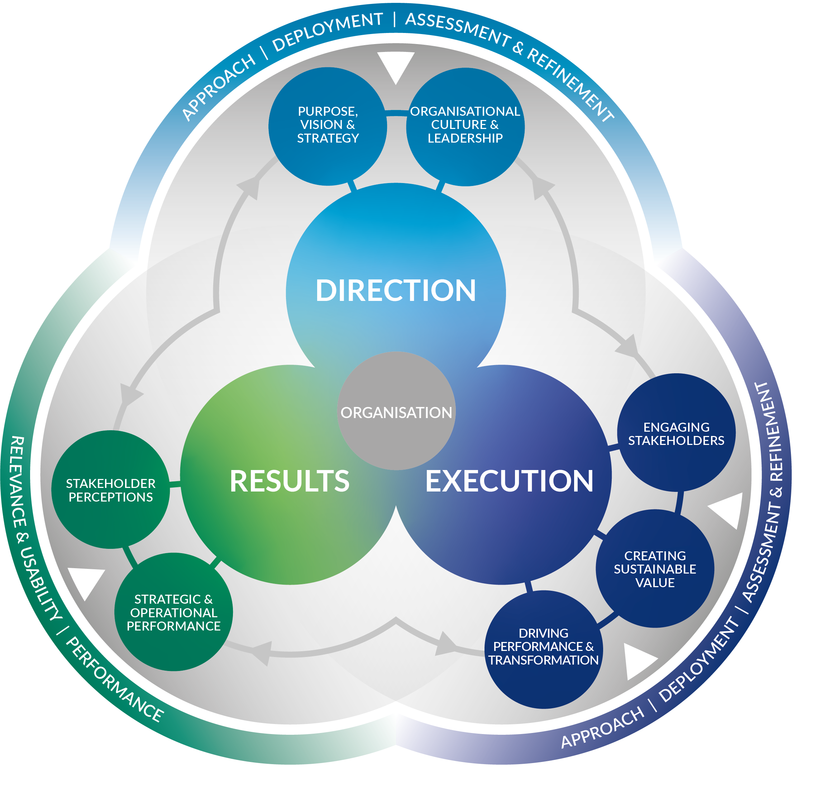
THE EFQM MODEL – Criteria framework
Publication: October 2019. Second updated edition in 2021.
Purpose: Supporting organizations in their efforts to develop management systems and improve performance.
Character: A generic tool that does not contain requirements, but a set of criteria and guidance points that reflect best practice.
Areas of use:
Inspiration to improve.
Criteria for self-assessment.
Criteria for awarding the EFQM Global Award and similar national awards.
31/07/24
Advanced Quality Management Systems

Slide 19
THE EFQM MODEL – Criteria framework
1. Purpose, vision and strategy (100 p.)
DIRECTION
2. Organizational culture and leadership (100 p.)
31/07/24
Advanced Quality Management Systems

Slide 20
THE EFQM MODEL – Criteria framework
DIRECTION
For an organization to achieve and sustain outstanding results that meet or exceed the expectations of its stakeholders it:
Defines an insipiring purpose
Creates a vision that is aspirational
Develops a strategy that is centred on creating sustainable value
Builds a winning culture.
This direction setting prepares the way forward for the organization to be seen as a leader in its ecosystem and well positioned to execute its plans for the future.
31/07/24
Advanced Quality Management Systems

Slide 21
THE EFQM MODEL – Criteria framework
1. PURPOSE, VISION AND STRATEGY (100 p.)
An outstanding organization is defined by a purpose that inspires, a vision that is aspirational and a strategy that delivers.
Sub-criteria:
1.1 Define purpose and vision.
1.2 Identify and understand stakeholders needs.
1.3 Understand the ecosystem, own capabilities and major challenges.
1.4 Develop strategy.
1.5 Design and implement a governance and performance management system.
31/07/24
Advanced Quality Management Systems

Slide 22
THE EFQM MODEL – Criteria framework
1.2 Identify & Understand Stakeholders Needs
In practice, we find that an outstanding organisation:
Identifies the stakeholders within its ecosystem and prioritises on those that it sees as the Key Stakeholders, i.e. those with the potential to help or hinder the achievement of the Purpose, Vision and Strategy.
Understands how its Purpose and Vision affects these Key Stakeholders.
Identifies Key Stakeholder needs and expectations, considering them within the context of the organisation’s own Purpose and Vision.
Analyses the factors that influence the behaviours, relationships and decision-making of Key Stakeholders and how it may be affected by them.
Studies and understands Key Stakeholder competences and strategies and responds appropriately to how these could affect its Purpose, Vision, Strategy and business model.
31/07/24
Advanced Quality Management Systems

Slide 23
THE EFQM MODEL – Criteria framework
Organizational culture is the specific collection of values and norms that are shared by people and groups within an organization that influence over time, the way they behave with each other and with key stakeholders outside the organization.
2. ORGANIZATIONAL CULTURE AND LEADERSHIP (100 p.)
Sub-criteria:
2.1 Steer the organization´s culture and nurture values.
2.2 Create the conditions for realising change.
2.3 Enable creativity and innovations.
2.4 Unite behind and engage in purpose, vision and strategy.
31/07/24
Advanced Quality Management Systems

Slide 24
THE EFQM MODEL – Criteria framework
3. Engaging stakeholders (100 p.)
EXECUTION
4. Creating sustainable value (200 p.)
5. Driving performance and transformation (100 p.)
31/07/24
Advanced Quality Management Systems

Slide 25
THE EFQM MODEL – Criteria framework
EXECUTION
The direction setting as outlined above (see section „Direction”), prepares the way forward for the organization, but it then needs to execute its strategy effectively and efficiently, ensuring that it:
Knows who the stakeholders are in its ecosystem and engages fully with those that are key to its success.
Creates sustainable value.
Drives the levels of performance necessary for success today and, at the same time, drives the necessary improvement and transformation if it is to be successful in the future.
31/07/24
Advanced Quality Management Systems

Slide 26
THE EFQM MODEL – Criteria framework
3. ENGAGING STAKEHOLDERS (100 p.)
Having decided which stakeholders are the most important to the organization and independent of the specific groups identified, it is highly likely that there is a degree of similarity in applying the engaging with key stakeholders.
Sub-criteria:
3.1 Customers: Build sustainable development.
3.2 People: Attract, engage, develop and retain.
3.3 Business and governing stakeholders: Secure and sustain ongoing support.
3.4 Society: Contribute to development, well-being and prosperity.
3.5 Partners and Suppliers: Build relationship and ensure support for creating sustainable value.
31/07/24
Advanced Quality Management Systems

Slide 27
THE EFQM MODEL – Criteria framework
4. CREATING SUSTAINABLE VALUE (200 p.)
An outstanding organization recognizes that creating sustainable value is vital for its long-term success and financial strength.
Sub-criteria:
4.1 Design the value and how it is created.
4.2 Communicate and sell the value.
4.3 Deliver the value.
4.4 Define and implement the overall experience.
31/07/24
Advanced Quality Management Systems

Slide 28
THE EFQM MODEL – Criteria framework
4.1 Design the Value & How it is Created
In practice, we find that an outstanding organisation:
Understands what differentiates it from others, including, where relevant, its competitors, and makes these differentiators an integral part of the value it creates.
Involves its Key Stakeholders in the development process to (co-)create and maximise value.
Develops the portfolio of its products, services and solutions in line with its Purpose and the current and future needs of existing and potential target groups.
Designs the value and the value creation approaches to reflect their lifecycle in a responsible way, considering impacts on public health, safety and the environment.
Uses quantitative and qualitative market research, (customer) surveys and other forms of feedback, as well as insights, to develop and improve its value proposition and value creation.
31/07/24
Advanced Quality Management Systems

Slide 29
THE EFQM MODEL – Criteria framework
5. DRIVING PERFORMANCE AND TRANSFORMATION (100 p.)
Now and in the future, an organization needs to be able to meet the following these two important requirements at the same time to become and remain successful.
Sub-criteria:
5.1 Drive performance and manage risk.
5.2 Transform the organization for future.
5.3 Drive Innovation and utilise technology.
5.4 Leverage data, information and knowledge.
5.5 Manage assets and resources.
31/07/24
Advanced Quality Management Systems

Slide 30
THE EFQM MODEL – Criteria framework
6. Stakeholder perception (200 p.)
RESULTS
7. Strategic and operational performance (200 p.)
31/07/24
Advanced Quality Management Systems

Slide 31
THE EFQM MODEL – Criteria framework
RESULTS
What the organization has achieved in relation to what has been described in the „Direction” and „Execution” sections, including the forecast for the future. In practice, an outstanding organization provides results data for:
Stakeholders perception.
Creating sustainable value.
Driving performance and transformation.
31/07/24
Advanced Quality Management Systems

Slide 32
THE EFQM MODEL – Criteria framework
6. STAKEHOLDER PERCEPTION (200 p.)
This criterion concentrates on results based on feedback from key stakeholders about their personal experience of dealing with the organization – their perceptions.
Stakeholders perception could include minimally:
6.1 Customer perception results.
6.1 People perception results.
6.3 Business and governing stakeholders perception results.
6.4 Society perception results.
6.5 Partners and suppliers perception results.
31/07/24
Advanced Quality Management Systems

Slide 33
THE EFQM MODEL – Criteria framework
6.1 Customer Perception Results
What the perceptions of the Customers are in relation to, for instance:
The delivery of the overall customer experience.
The Culture of the organisation; the attitude and level of commitment to the customer by People.
The branding and reputation of the organisation, including its social and environmental performance.
The products, services and solutions offered by the organisation.
The use of innovation to improve the organisation’s processes, products, services and solutions.
The usage of technology by the organisation to help deliver sustainable value.
The delivery and after-sales support for the different channels.
The effectiveness and efficiency of the communication channels used.
31/07/24
Advanced Quality Management Systems

Slide 34
THE EFQM MODEL – Criteria framework
7. STRATEGIC AND OPERATIONAL PERFORMANCE (200 p.)
This criterion concentrates on results linked to the organization´s performance in terms of: the ability to fulfil its purpose, deliver the strategy, create sustainable value and its fitness for the future.
Strategic and operational performance indicators could include, but are not limited to:
Achievements in delivering its purpose and creating sustainable value.
Financial performance.
Fulfilment of key stakeholders expectations.
Achievements of strategic objectives.
Achievements in driving performance and transformation.
Predictive measures for the future.
31/07/24
Advanced Quality Management Systems

Slide 35
THE EFQM MODEL – Summary
Models of excellence are now used in more than 80 countries around the world.
The EFQM Model (excellence) alone is currently used by approximately 50,000 organisations worldwide.
Working with excellence models has been shown to lead to improvements in all aspects of an organisation's activities.
The primary condition for improvement is systematic self-assessment of organisations, for which excellence models are a key assessment framework.
The vast majority of organisations use excellence models as strategic tools only for their own development. Only around 10% of organisations aim to succeed in competitions for national or multinational awards.
On the one hand, organisations value the flexibility and versatility of excellence models, but on the other hand, working with them requires creativity of people.
31/07/24
Advanced Quality Management Systems

Slide 36
The nature, procedures and techniques of self-assessment
According to EFQM, model version 2013:
„It is a comprehensive, systematic and regular review of an organisation´s activities and results referenced against a model of business excellence.“
Purpose of self-assessment:
to identify strengths and weaknesses of the organisation´s management systém;
to support continuous improvement culture.
31/07/24
Advanced Quality Management Systems

Slide 37
SELF-ASSESSMENT - QUANTIFICATION USING RADAR
Determine the RESULTS
Plan and develop APPROACHES
DEPLPOYMENT the approaches
ASSESS and IMPROVE approaches and their extension
RADAR
31/07/24
Advanced Quality Management Systems

Slide 38
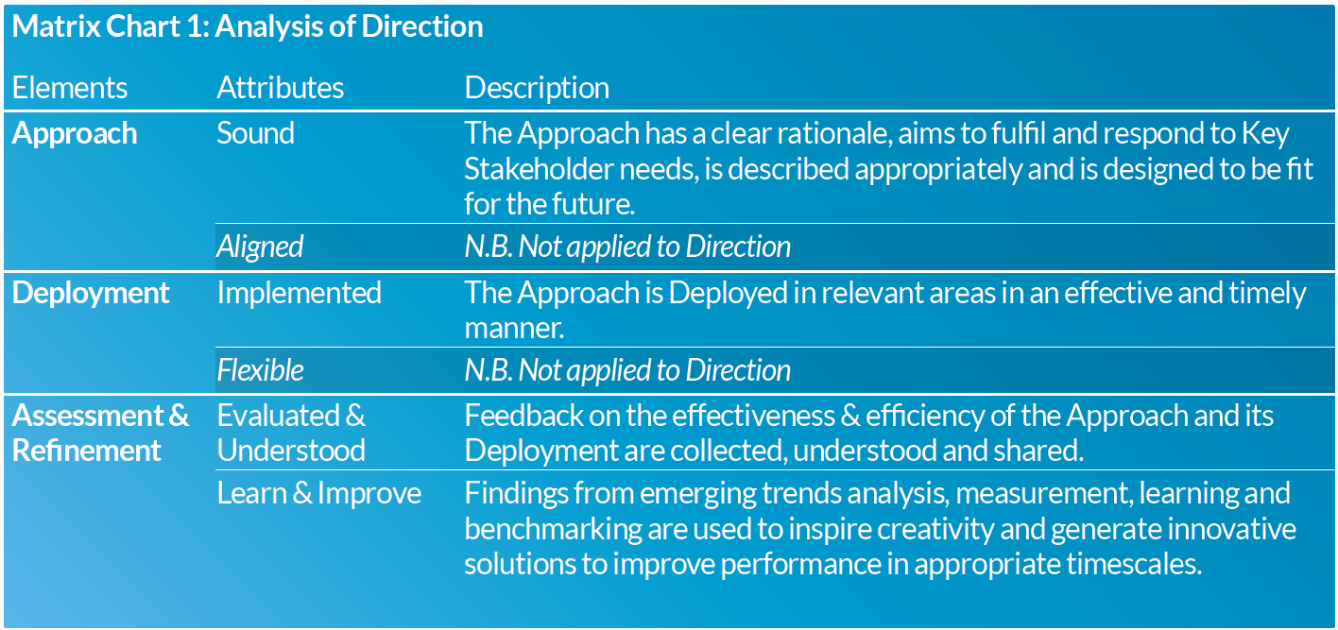
RADAR: Analysis of Direction
31/07/24
Advanced Quality Management Systems

Slide 39
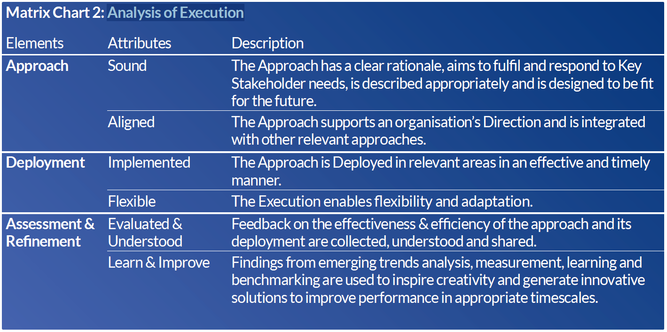
RADAR: Analysis of Execution
31/07/24
Advanced Quality Management Systems

Slide 40
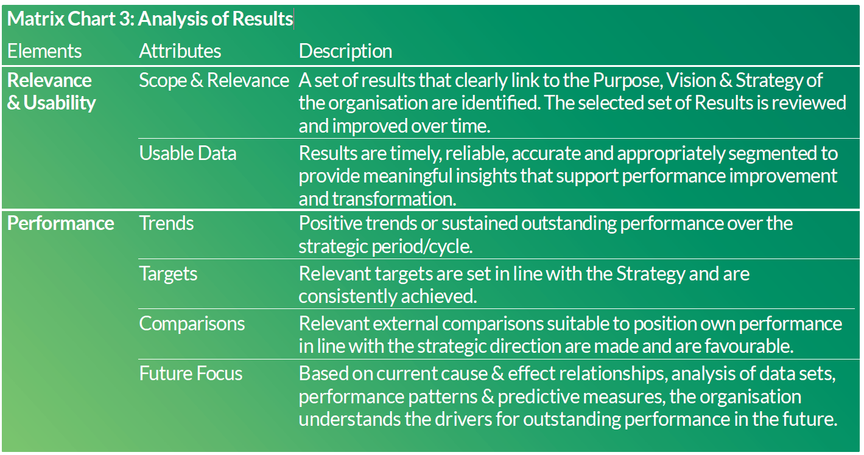
RADAR: Analysis of Results
31/07/24
Advanced Quality Management Systems

Slide 41
THE CORE SELF-ASSESSMENT – Basic steps
Data collection
Reaching the assessment consensus
Self-assessment report preparation
Review if data are entire
Assessment against model criteria
Identification of strengths and weaknesses
1.
Individually by interview, record analysis, observation, etc.
2.
Individually with respect to needs of following steps.
3.
Individually with regard to BEM.
4.
Individual scoring with support of RADAR frame.
5.
By team-work with support of RADAR frame.
6.
By team-work on purpose top management review.
31/07/24
Advanced Quality Management Systems

Slide 42
MODELS OF EXCELLENCE - Basic prerequisites for success
The honest interest of top management - the will to know the truth.
The existence of the organization's declared strategic intentions.
Understanding the meaning and essence of self-assessment by employees.
Adoption of a generally accepted criterion model.
A specially prepared team of assessors.
Release of necessary resources for self-evaluation.
Motivating and leading employees to identify opportunities for improvement.
Willingness to know the truth about the real performance of the organization.
Using appropriate indicators to measure and monitor results.
Separation of two segments of self-evaluation on how we work and what we achieve.
31/07/24
Advanced Quality Management Systems

Slide 43
Thank you for your attention
David VYKYDAL
Department of Quality Management
david.vykydal@vsb.cz
Transformation of the structure and content of higher education at VŠB-TUO
NPO VŠB-TUO MSMT-16605/2022

