Slide 1



Vyvažování letadel – neřešené příklady
Ing. Cíleček Jakub

Slide 2
Obsah
Úvodní informace k řešení
Potřebné dokumenty a formuláře
Zadání neřešených příkladů

Slide 3
Úvodní informace k řešení
V následujících slidech budou uvedeny formuláře a dokumenty potřebné k řešení.
Možnost užití formulářů je dvojí a je na řešiteli, které grafické zpracování si k řešení vybere, výstup je vždy stejný.

Slide 4
Potřebné dokumenty a formuláře
 |  | Flight |  | Crew |  | Routing |  | Pantry |  | A/C Registration
 |  | Dry Operating Weigh and Index |  |  |  |  |  |  | DOI
 |  | Correction FC
 |  | Correction CC
 |  | Correction water
 |  | Corrected DOW and DOI
 |  | PAX |  | Adults |  | kg | + |  |  |  |  | MZFW | 62500
 |  | BAGS |  | Bags |  | kg | + |  |  |  |  | MTOW | 75500
 |  | Cargo |  |  |  | kg | + |  |  |  |  | MLW | 66000
 |  | Mail |  |  |  | kg | +
 |  | Estimated Traffic Load |  |  |  |  | = |  |  |  |  | Block Fuel
 |  | Corrected DOW |  |  |  |  | + |  |  |  |  | Taxi Fuel
 |  | Estimated Zero Fuel Weight |  |  |  |  | = |  |  |  |  | Trip Fuel
 |  | Minimum Take Off Fuel |  |  |  |  | + |  |  |  |  | Min Take Off Fuel
 |  | Estimated Take Off Weight |  |  |  |  | =
 |  |  |  |  |  | Maximum Weights For |  |  | Zero Fuel |  | Take Off |  | Landing
 |  |  |  |  |  | Take Off Fuel |  | + |  |  |  |  |  |  | + | Trip Fuel
 | Corrected DOW |  |  |  |  | Allowed Weight For Take Off (choose lowest a,b,c) |  |  | a |  | b |  | c
 | Take Off Fuel |  | + |  |  | Operating Weight |  | -
 | Operating Weight |  | = |  |  | Allowed Traffic Load |  | =
Lowest of b,c |  |  |  |  |  |  |  | 0A | 0B | 0C | Total
EZFW |  |  | - |  |  |  | Seats | 57 | 54 | 54 | 165
Allowed Take Off Fuel |  |  | = |  |  |  | PAX
 |  |  |  |  |  |  | Index obsazenosti

Slide 5
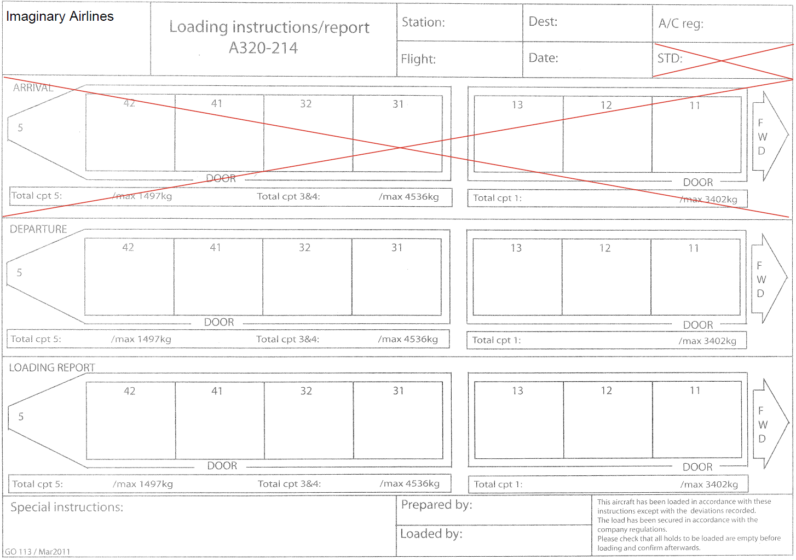

Slide 6
 |  |  |  |  | Station |  |  | Destination |  |  | A/C registration
 |  |  |  |  | Flight |  |  |  | Date
DEPARTURE
AFT |  |  |  |  |  |  |  |  |  |  | FWD
CPT5 |  | CPT42 |  | CPT41 |  | CPT32 |  | CPT31 |  |  | CPT13 |  | CPT12 |  | CPT11
 |  |  |  | DOOR |  |  |  |  |  |  |  |  |  |  | DOOR
Total CPT5 |  | Total CPT4 |  | Total CPT3 |  |  |  |  |  |  |  |  | Total CPT1
MAX |  | MAX |  |  |  |  |  |  |  |  |  |  | MAX
1500 kg |  | 4500 kg |  |  |  |  |  |  |  |  |  |  | 3400 kg
Loading Report
AFT |  |  |  |  |  |  |  |  |  |  | FWD
CPT5 |  | CPT42 |  | CPT41 |  | CPT32 |  | CPT31 |  |  | CPT13 |  | CPT12 |  | CPT11
 |  |  |  | DOOR |  |  |  |  |  |  |  |  |  |  | DOOR
Total CPT5 |  | Total CPT4 |  | Total CPT3 |  |  |  |  |  |  |  |  | Total CPT1
MAX |  | MAX |  |  |  |  |  |  |  |  |  |  | MAX
1500 kg |  | 4500 kg |  |  |  |  |  |  |  |  |  |  | 3400 kg

Slide 7
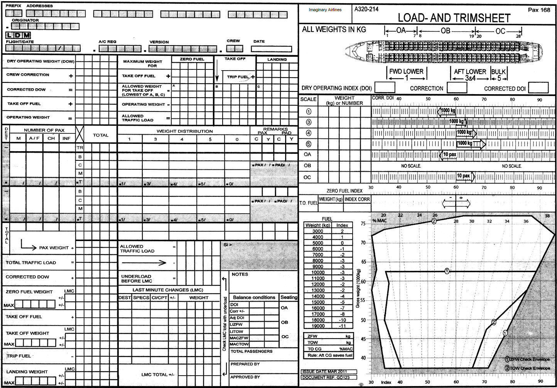

Slide 8
Příklad 1
Předběžné údaje |  |  |  |  | Finální hodnoty
Data o letu |  |  |  |  | Passangers
Číslo letu | IA1545 |  |  |  | Total | 83
Routing | PRG-BRU |  |  |  | Gender split
A/C typ | A320 |  |  |  | Male | 40
A/C rego | OK-HJD |  |  |  | Female | 40
Crew | 2/4 |  |  |  | Child | 3
Pantry | S |  |  |  | Infant | 0
Data o letadle |  |  |  |  | Seating
DOW | 47500 kg |  |  |  | 0A | 30
DOI | 63,0 |  |  |  | 0B | 23
MZFW | 62500 kg |  |  |  | 0C | 30
MTOW | 75500 kg |  |  |  | Baggages
MLW | 66000 kg |  |  |  | Total | 98
Kapacita A/C | 165PAX |  |  |  | Weight | 1470
Kapacita sedadlových zón | 0A | 57 |  |  | Cargo
 | 0B | 54 |  |  | Total | 950
 | 0C | 54 |  |  | Mail
Data o cestujících |  |  |  |  | Total | 200
Booked PAX | 110 |  |  |  | Fuel
Hmotnost 1PAX | 80 kg |  |  |  | Block F. | 10000
Bags | 1,5ks/pax |  |  |  | Taxi F. | 200
Bags weight | 12 kg/ks |  |  |  | Trip F. | 7000
Další údaje |  |  |  |  | Take Off F. | 9800
Cargo | 950 kg
Mail | 200 kg
Fuel Figures
Block Fuel | 9500
Taxi Fuel | 120
Trip Fuel | 6700
Take Off Fuel | 9380

Slide 9
Příklad 2
Předběžné údaje |  |  |  |  | Finální hodnoty
Data o letu |  |  |  |  | Passangers
Číslo letu | IA4589 |  |  |  | Total | 163
Routing | OSR-BOJ |  |  |  | Gender split
A/C typ | A320 |  |  |  | Male | 80
A/C rego | OK-DKS |  |  |  | Female | 80
Crew | 2/4 |  |  |  | Child | 3
Pantry | S |  |  |  | Infant | 0
Data o letadle |  |  |  |  | Seating
DOW | 43000 |  |  |  | 0A | 57
DOI | 50,0 |  |  |  | 0B | 54
MZFW | 62500 kg |  |  |  | 0C | 52
MTOW | 75500 kg |  |  |  | Baggages
MLW | 66000 kg |  |  |  | Total | 150
Kapacita A/C | 165PAX |  |  |  | Weight | 1200
Kapacita sedadlových zón | 0A | 57 |  |  | Cargo
 | 0B | 54 |  |  | Total | 445
 | 0C | 54 |  |  | Mail
Data o cestujících |  |  |  |  | Total | 625
Booked PAX | 159 |  |  |  | Fuel
Hmotnost 1PAX | 80 kg |  |  |  | Block F. | 11200
Bags | 1,2ks/pax |  |  |  | Taxi F. | 200
Bags weight | 10 kg/ks |  |  |  | Trip F. | 9500
Další údaje |  |  |  |  | Take Off F. | 11000
Cargo | 450
Mail | 600
Fuel Figures
Block Fuel | 11000
Taxi Fuel | 120
Trip Fuel | 9000
Take Off Fuel | 10880

Slide 10
Příklad 3
Předběžné údaje |  |  |  |  | Finální hodnoty
Data o letu |  |  |  |  | Passangers
Číslo letu | IA5689 |  |  |  | Total | 143
Routing | VIE-LHR |  |  |  | Gender split
A/C typ | A320 |  |  |  | Male | 90
A/C rego | OK-UWG |  |  |  | Female | 50
Crew | 2/4 |  |  |  | Child | 3
Pantry | S |  |  |  | Infant | 0
Data o letadle |  |  |  |  | Seating
DOW | 46730 |  |  |  | 0A | 46
DOI | 55,0 |  |  |  | 0B | 51
MZFW | 62500 kg |  |  |  | 0C | 46
MTOW | 75500 kg |  |  |  | Baggages
MLW | 66000 kg |  |  |  | Total | 120
Kapacita A/C | 165PAX |  |  |  | Weight | 1560
Kapacita sedadlových zón | 0A | 57 |  |  | Cargo
 | 0B | 54 |  |  | Total | 320
 | 0C | 54 |  |  | Mail
Data o cestujících |  |  |  |  | Total | 0
Booked PAX | 139 |  |  |  | Fuel
Hmotnost 1PAX | 80 kg |  |  |  | Block F. | 11900
Bags | 0,8ks/pax |  |  |  | Taxi F. | 200
Bags weight | 15 kg/ks |  |  |  | Trip F. | 9000
Další údaje |  |  |  |  | Take Off F. | 11700
Cargo | 300
Mail | 0
Fuel Figures
Block Fuel | 12000
Taxi Fuel | 120
Trip Fuel | 9300
Take Off Fuel | 11880

Slide 11
Příklad 4
Předběžné údaje |  |  |  |  | Finální hodnoty
Data o letu |  |  |  |  | Passangers
Číslo letu | IA4521 |  |  |  | Total | 165
Routing | LTN-OSR |  |  |  | Gender split
A/C typ | A320 |  |  |  | Male | 80
A/C rego | OK-TGV |  |  |  | Female | 85
Crew | 2/4 |  |  |  | Child | 0
Pantry | S |  |  |  | Infant | 0
Data o letadle |  |  |  |  | Seating
DOW | 42356 |  |  |  | 0A | 57
DOI | 51,6 |  |  |  | 0B | 54
MZFW | 62500 kg |  |  |  | 0C | 54
MTOW | 75500 kg |  |  |  | Baggages
MLW | 66000 kg |  |  |  | Total | 150
Kapacita A/C | 165PAX |  |  |  | Weight | 1650
Kapacita sedadlových zón | 0A | 57 |  |  | Cargo
 | 0B | 54 |  |  | Total | 0
 | 0C | 54 |  |  | Mail
Data o cestujících |  |  |  |  | Total | 0
Booked PAX | 165 |  |  |  | Fuel
Hmotnost 1PAX | 80 kg |  |  |  | Block F. | 11400
Bags | 0,9ks/pax |  |  |  | Taxi F. | 200
Bags weight | 13 kg/ks |  |  |  | Trip F. | 8500
Další údaje |  |  |  |  | Take Off F. | 11200
Cargo | 0
Mail | 0
Fuel Figures
Block Fuel | 11500
Taxi Fuel | 120
Trip Fuel | 8700
Take Off Fuel | 11380

Slide 12
Příklad 5
Předběžné údaje |  |  |  |  | Finální hodnoty
Data o letu |  |  |  |  | Passangers
Číslo letu | IA1593 |  |  |  | Total | 85
Routing | WAW-FCO |  |  |  | Gender split
A/C typ | A320 |  |  |  | Male | 80
A/C rego | OK-AUR |  |  |  | Female | 5
Crew | 2/4 |  |  |  | Child | 0
Pantry | S |  |  |  | Infant | 0
Data o letadle |  |  |  |  | Seating
DOW | 49512 |  |  |  | 0A | 30
DOI | 63,2 |  |  |  | 0B | 25
MZFW | 62500 kg |  |  |  | 0C | 30
MTOW | 75500 kg |  |  |  | Baggages
MLW | 66000 kg |  |  |  | Total | 200
Kapacita A/C | 165PAX |  |  |  | Weight | 1000
Kapacita sedadlových zón | 0A | 57 |  |  | Cargo
 | 0B | 54 |  |  | Total | 200
 | 0C | 54 |  |  | Mail
Data o cestujících |  |  |  |  | Total | 350
Booked PAX | 120 |  |  |  | Fuel
Hmotnost 1PAX | 80 kg |  |  |  | Block F. | 10000
Bags | 2ks/pax |  |  |  | Taxi F. | 200
Bags weight | 14 kg/ks |  |  |  | Trip F. | 6300
Další údaje |  |  |  |  | Take Off F. | 9800
Cargo | 200
Mail | 250
Fuel Figures
Block Fuel | 9700
Taxi Fuel | 120
Trip Fuel | 6200
Take Off Fuel | 9580

Slide 13
Děkuji za pozornost
Ing. Jakub Cíleček
jakub.cilecek@vsb.cz
Toto dílo je licencováno pod CC BY 4.0
O
NPO_VŠB-TUO_MSMT-16605/2022

