Slide 1


INTEGRATED MANAGEMENT SYSTEMS
David Vykydal Eva Tylečková
© Integrated Management Systems © 2024 by David Vykydal, Eva Tylečková is licensed under CC BY-NC 4.0
© VSB - Technical University of Ostrava

Slide 2
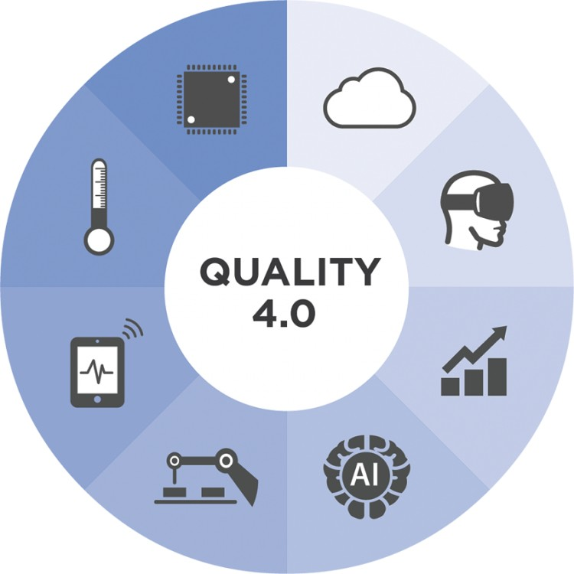
INTEGRATED MANAGEMENT SYSTEMS
According to PAS 99:2012
„Management system that integrates all of an organization´s systems and processes into one complete framework, enabling an organization to work as a single unit with unified objectives.”
Model of hand- crafted production
Production model with sampling inspection
Model of TQM
Integration of partial management systems
Organizational excellence!!!
1900
1940
1975
1999
?
Production model with quality inspection
Model of process control (CWQC)
The ISO Model of QMS
1920
1960
1987
31/07/24
Advanced Quality Management Systems

Slide 3
Benefits of integrating management systems?
Improved strategic and business focus.
A more holistic approach to managing risks and opportunities.
Harmonization and optimization of organization´s processes.
Less conflicts between formal management systems.
Reduced duplication and bureaucracy.
Better good practice sharing within the organization.
Improved internal communication.
Simplified internal and external conformity assessment.
Reduced cost related to management system maintenance and development.
Easier facilitation of the requirements of any new management system standards
Creation of efficient platform for organizational excellence.
31/07/24
Advanced Quality Management Systems

Slide 4
INTEGRATED MANAGEMENT SYSTEMS
In particular, 3 management systems were initially integrated:
Quality Management System (QMS).
Environmental Management System (EMS).
Occupational Health and Safety Management System (OHSMS).
Over time, other management systems have been integrated.
Environmental Management System
IMS
Quality Management System
Occupational Health and Safety Management System
31/07/24
Advanced Quality Management Systems

Slide 5
Common elements
EMS (ISO 14 001)
and
OHSMS (ISO 45 001)
Common elements
EMS (ISO 14 001)
and
QMS (ISO 9001)
ISO 14 001
ISO 9 001
ISO 45 001
Common elements of all three SMs:
- internal audits,
- non-compliance management,
- management reviews,
- continuous improvement,
- etc.
Common elements
QMS (ISO 9001)
and
OHSMS (ISO 45001)
31/07/24
Advanced Quality Management Systems

Slide 6
IMS – COMMON REQUIREMENTS
Management policy establishing and communication
Top management commitment
Management objectives establishing and communication
Planning to achieve management objectives
Management of external providers
Assignment of relevant responsibilities and authorities
Control of documented information
Work environment control
31/07/24
Advanced Quality Management Systems

Slide 7
IMS – COMMON REQUIREMENTS
Internal communication
Ensuring of people competence
Management of infrastructure
Risk assessment and preventive actions
Internal auditing
Management review
Continual improvement
31/07/24
Advanced Quality Management Systems

Slide 8
Quality management system
Information Security Management System
Environmental Management System
IMS
other management systems ...
Energy management system
Occupational Health and Safety Management System
Corporate Social Responsibility Management System
31/07/24
Advanced Quality Management Systems

Slide 9
WHAT ABOUT „ANNEX SL!“ ?
Annex SL has been established a new and common structure of all ISO management system standards.
It has launched common terms and definitions.
It supports harmonization of publishing different standards throughout the world.
It leads to simplification of management systems standards.
It enables better and more effective management systems integration as well s documentation of such system.
31/07/24
Advanced Quality Management Systems

Slide 10

ANNEX SL - Basis of documentation in IMS
New structure of management systems:
Scope
Normative references
Terms and definitions
Context of the organization
Leadership
Planning
Support
Operation
Performance evaluation
Improvement
31/07/24
Advanced Quality Management Systems

Slide 11
WHAT ABOUT PAS 99:2012?
This British standard has been published by BSI on 2012. It determines basic set of common management system requirements. Basic features of this standard:
It was produced to enable organizations to integrate different management systems into one framework.
It should be primarily used by those organizations which are implementing the requirements of two or more management systems standards.
Basic requirements related to the integrated management system are associated with word „shall“.
These basic requirements are already linked to additional commentary and recommendations.
Compliance with this standard does not itself ensure conformity with any other management system standards or specifications.
New structure of the standard uses the same categorization as Annex SL of ISO Guide 83.
31/07/24
Advanced Quality Management Systems

Slide 12
INTEGRATED MANAGEMENT SYSTEMS – Development principle
Specific
requirements
for QMS
Specific
requirements
for EMS
Specific
requirements
for OHSMS
Specific
requirements
for other man. systems
Common requirements for all management systems
IMS
31/07/24
Advanced Quality Management Systems

Slide 13
Conditions and prerequisites for successful integration?
Support and active participation of senior management.
Understanding, support and systematic application of the principles of modern management systems.
Understanding the benefits of implementing and continuously improving the level of the management system.
Quality, environmental, safety, etc. aspects must become part of the organisation's strategy.
Employee knowledge and commitment.
Provision of adequate resources.
31/07/24
Advanced Quality Management Systems

Slide 14
Types of integration
Types of integration | Charakteristika
Additional integration of special industry requirements | Incorporation of special requirements of certain manufacturing industries (pharmaceutical industry, food industry, etc.) into existing quality management systems (ISO 9001).
Natural integration of the specific requirements of selected industries | Implementation of special requirements of manufacturing industries (e.g. automotive industry), which have been gradually embedded in internationally valid standards (IATF 16 949, AQAP and others), which must be respected by all suppliers.
Integrated management systems | Most often this involves the integration of quality management (QMS), environmental management (EMS) and occupational health and safety (OHS), but nowadays others may be added.
Comprehensive enterprise integration | Support for individual isolated systems and subsystems of the organization. Existing management systems, departments and functions within the organisation connect to the entire value chain from supplier to customer.
31/07/24
Advanced Quality Management Systems

Slide 15
Selected areas of integrated management systems
Area of management | Standard
Quality management | ČSN EN ISO 9001
Environmental management | ČSN EN ISO 14001
Occupational health and safety management | ČSN EN ISO 45001
Information security management | ČSN ISO/IEC 27001
Social responsibility of organizations | ČSN ISO 26000
Management of energy management | ČSN EN ISO 50001
Supply chain security management | ČSN ISO 28000
Service management | ČSN ISO/IEC 20000
Food safety management | ČSN EN ISO 22000
Business continuity management | ČSN ISO 22301
31/07/24
Advanced Quality Management Systems

Slide 16
Thank you for your attention
David VYKYDAL
Department of Quality Management
david.vykydal@vsb.cz
Transformation of the structure and content of higher education at VŠB-TUO
NPO VŠB-TUO MSMT-16605/2022

