Slide 1


QUALITY 4.0 Closed-loop quality management systems
David Vykydal Eva Tylečková
© Closed-loop Quality Management Systems © 2024 by David Vykydal, Eva Tylečková is licensed under CC BY-NC 4.0
© VSB - Technical University of Ostrava

Slide 2
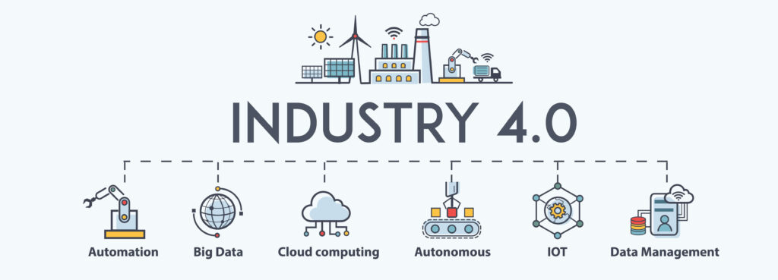
QUALITY 4.0 Closed-loop quality management systems
„The theme Quality 4.0 is based on the concept of Industry 4.0, which is the term for the fourth industrial (r)evolution. The current fourth industrial (r)evolution is leading to new paradigms of quality, processes and technologies."
Industry 4.0 represents the current trend of digital transformation, with its associated automation. It is associated with the emergence of so-called "smart factories" where modern technologies will be used:
Internet of Things,
artificial intelligence,
virtual and augmented reality,
cloud computing, 3D printing,
Big Data, etc.
31/07/24
Advanced Quality Management Systems

Slide 3
WHAT IS „QUALITY 4.0“?
This concept is associated with the term "Industry 4.0" and encompasses all areas of advanced quality management in the digital era.
Quality 4.0 focuses primarily on four areas of quality management: design and development, manufacturing, services and corporate culture.
Special attention is paid to methods and tools that enable flexible communication and effective feedback in the B2B area.
Extensive IT support is a key prerequisite for the practical implementation of the Quality 4.0 concept in an industrial environment.
Reliable and fast connectivity and interaction between infrastructure, people, business units and stakeholders is not the goal, it is only a means for continuous improvement and innovation.
31/07/24
Advanced Quality Management Systems

Slide 4
WHAT IS „QUALITY 4.0“?
The Quality 4.0 concept effectively combines new technologies (cloud computing, big data, artificial intelligence, machine learning, Internet of things, etc.) with proven quality management methods and tools.
The TQM philosophy (active involvement of all employees) is a natural part of the Quality 4.0 concept.
Quality 4.0 is strongly oriented towards the application of predictive quality management activities.
The so-called closed-loop QMS are considered the most appropriate basis for implementing the Quality 4.0 concept in practice.
31/07/24
Advanced Quality Management Systems

Slide 5
QUALITY 4.0 AS CHALLENGE
Companies will have to be able to meet individual customer requirements even under conditions of large-scale production (customisation or personalisation of production).
Even in the conditions of agility organizations, it is necessary to keep quality-related expenses in optimal proportions.
Linking information sources is considered the key to reducing losses in management systems.
Information will be seen as a key raw material.
Flexible and online measurement of performance indicators will be possible for all processes, not just production processes.
31/07/24
Advanced Quality Management Systems

Slide 6
QUALITY 4.0 AS CHALLENGE
Communication barriers to collaboration between teams and departments are eliminated.
A new quality of internal and external communication in management systems will be achieved.
Customers become active participants in the design and development processes, but also in the production and delivery processes.
Product traceability becomes easy and objective.
The right data gets to the right places in the right (i.e. real) time.
31/07/24
Advanced Quality Management Systems

Slide 7
FEEDBACK IN QUALITY MANAGEMENT SYSTEM (QMS):
ISO 9000:2015:
„Opinions, comments and expressions of interest in a product, a service or a complaints-handling process.“
Business Dictionary:
„A process in which the consequences or our outputs are returned to us for possible future modification.“
31/07/24
Advanced Quality Management Systems

Slide 8
ZPĚTNÁ VAZBA V SMK:
Feedback from stakeholders
QUALITY MANAGEMENT SYSTEM
Planning and implementing necessary improvements and changes
Evaluation of feedback data and its communication
Analysing the causes of problems and lessons learned
31/07/24
Advanced Quality Management Systems

Slide 9
WHAT ARE CLOSED-LOOP QMS (CLQMS)?:
Definition:
„Part of an organisation's overall management system, using the principles of advanced quality management and enabling all quality management processes to be linked to performance data in order to achieve a higher level of quality (excellence) in the organisation.“
CLQMS
Consists of:
Internal feedback
External feedback
Usually includes:
Horizontal feedback
Vertical feedback
31/07/24
Advanced Quality Management Systems

Slide 10
CLQMS: Characteristics of different feedback loops
Feedback | Characteristics
Internal feedback | They cover the organization's internal processes and performance indicators. They are based on feedback from individual process owners. They focus primarily on the performance and capability of internal processes.
External feedback | They cover external processes and performance indicators. They are based on feedback from external stakeholders, especially customers. They focus primarily on the perceptions and opinions of external stakeholders.
Horizontal feedback | They are usually localized to only one level of management. They describe whether internal processes are under effective control. Interaction between internal processes is expected.
Vertical feedback | They are localized to at least two levels of control. They reveal whether feedback at the lower management level is working. Enables dissemination and review of how the organization's strategy and sub-policies are being implemented.
31/07/24
Advanced Quality Management Systems

Slide 11
Examples of feedback combinations according to requirements of ISO 9001
Internal - horizontal:
Outputs from the review of the context of the organization Inputs for design and development Requirements and results relating to audits
Internal - vertical:
Establishing responsibilities, authorities and roles in QMS processes Decision on the strategic direction of the organization Information on the unsuitability of the measuring equipment and the possible effects of this unsuitability
External - horizontal:
Information on the quality policy towards stakeholders Information on complaints and claims Outputs from the assessment of the competence or performance of QMS processes
External - vertical:
Knowledge and competences acquired from external sources Outputs from supplier compliance verification and supplier performance monitoring
31/07/24
Advanced Quality Management Systems

Slide 12
BENEFITS AND EFFECTS OF CLQMS
Enable product compliance at the 6 Sigma performance level.
They support the concept of early warning in the design and development phase.
Enable more accurate identification of customer and other stakeholder requirements.
They support the interconnection of different processes and management levels.
Create an environment for rapid intervention in situations where deviations from specifications occur.
31/07/24
Advanced Quality Management Systems

Slide 13
BENEFITS AND EFFECTS OF CLQMS
Minimise quality-related expenditure.
Reflect trends towards mass customisation of products.
Support quality assurance throughout the value chain.
Support effective and efficient assessment of risks and opportunities.
Strengthen the effectiveness of all phases of the PDCA or DMAIC cycle.
They create the conditions for the long-term competitiveness of organisations.
31/07/24
Advanced Quality Management Systems

Slide 14
RISKS AND BARRIERS TO THE IMPLEMENTATION OF CLQMS
Implementation is very time and investment intensive.
Implementation is not possible without a defined vision in quality management.
Mental stereotypes and reluctance of top managers can be an obstacle.
New knowledge and competences of employees are required, including operators of production facilities.
The provision of extensive and up-to-date IT support and close cooperation with IT specialists is necessary.
Radical solutions or higher-level innovations are also required.
31/07/24
Advanced Quality Management Systems

Slide 15
Thank you for your attention
David VYKYDAL
Department of Quality Management
david.vykydal@vsb.cz
Transformation of the structure and content of higher education at VŠB-TUO
NPO VŠB-TUO MSMT-16605/2022

